Slide 1
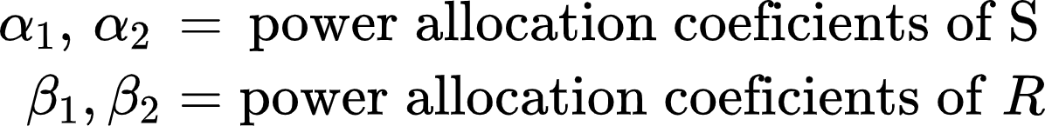
Scrambling codes for Decode and forward NOMA scheme
There exists a unique scrambling for each geographical region
Ps = transmission power of S
Pr = transmission power of R
S1 = Scrambling code of region 1
S2 = Scrambling code of region 2
h1= channel coefficient of S-D link
h2 = channel coefficient of R-D link
n= gaussian noise
Region 1
R
S2
h2
Region 2
S
h1
D
S1
S3
Received signal at D:

Slide 2
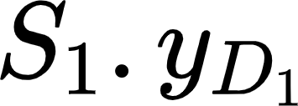
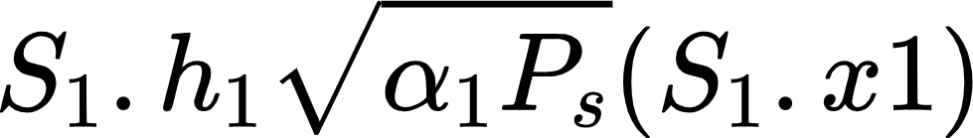
Decoding received signals: first decoding one NOMA signal
Decoding each symbol in noma signal by successive interference cancellation
Decode x1 (by MAP estimator)
x1
-
Decode x2
x2

